Slide 1
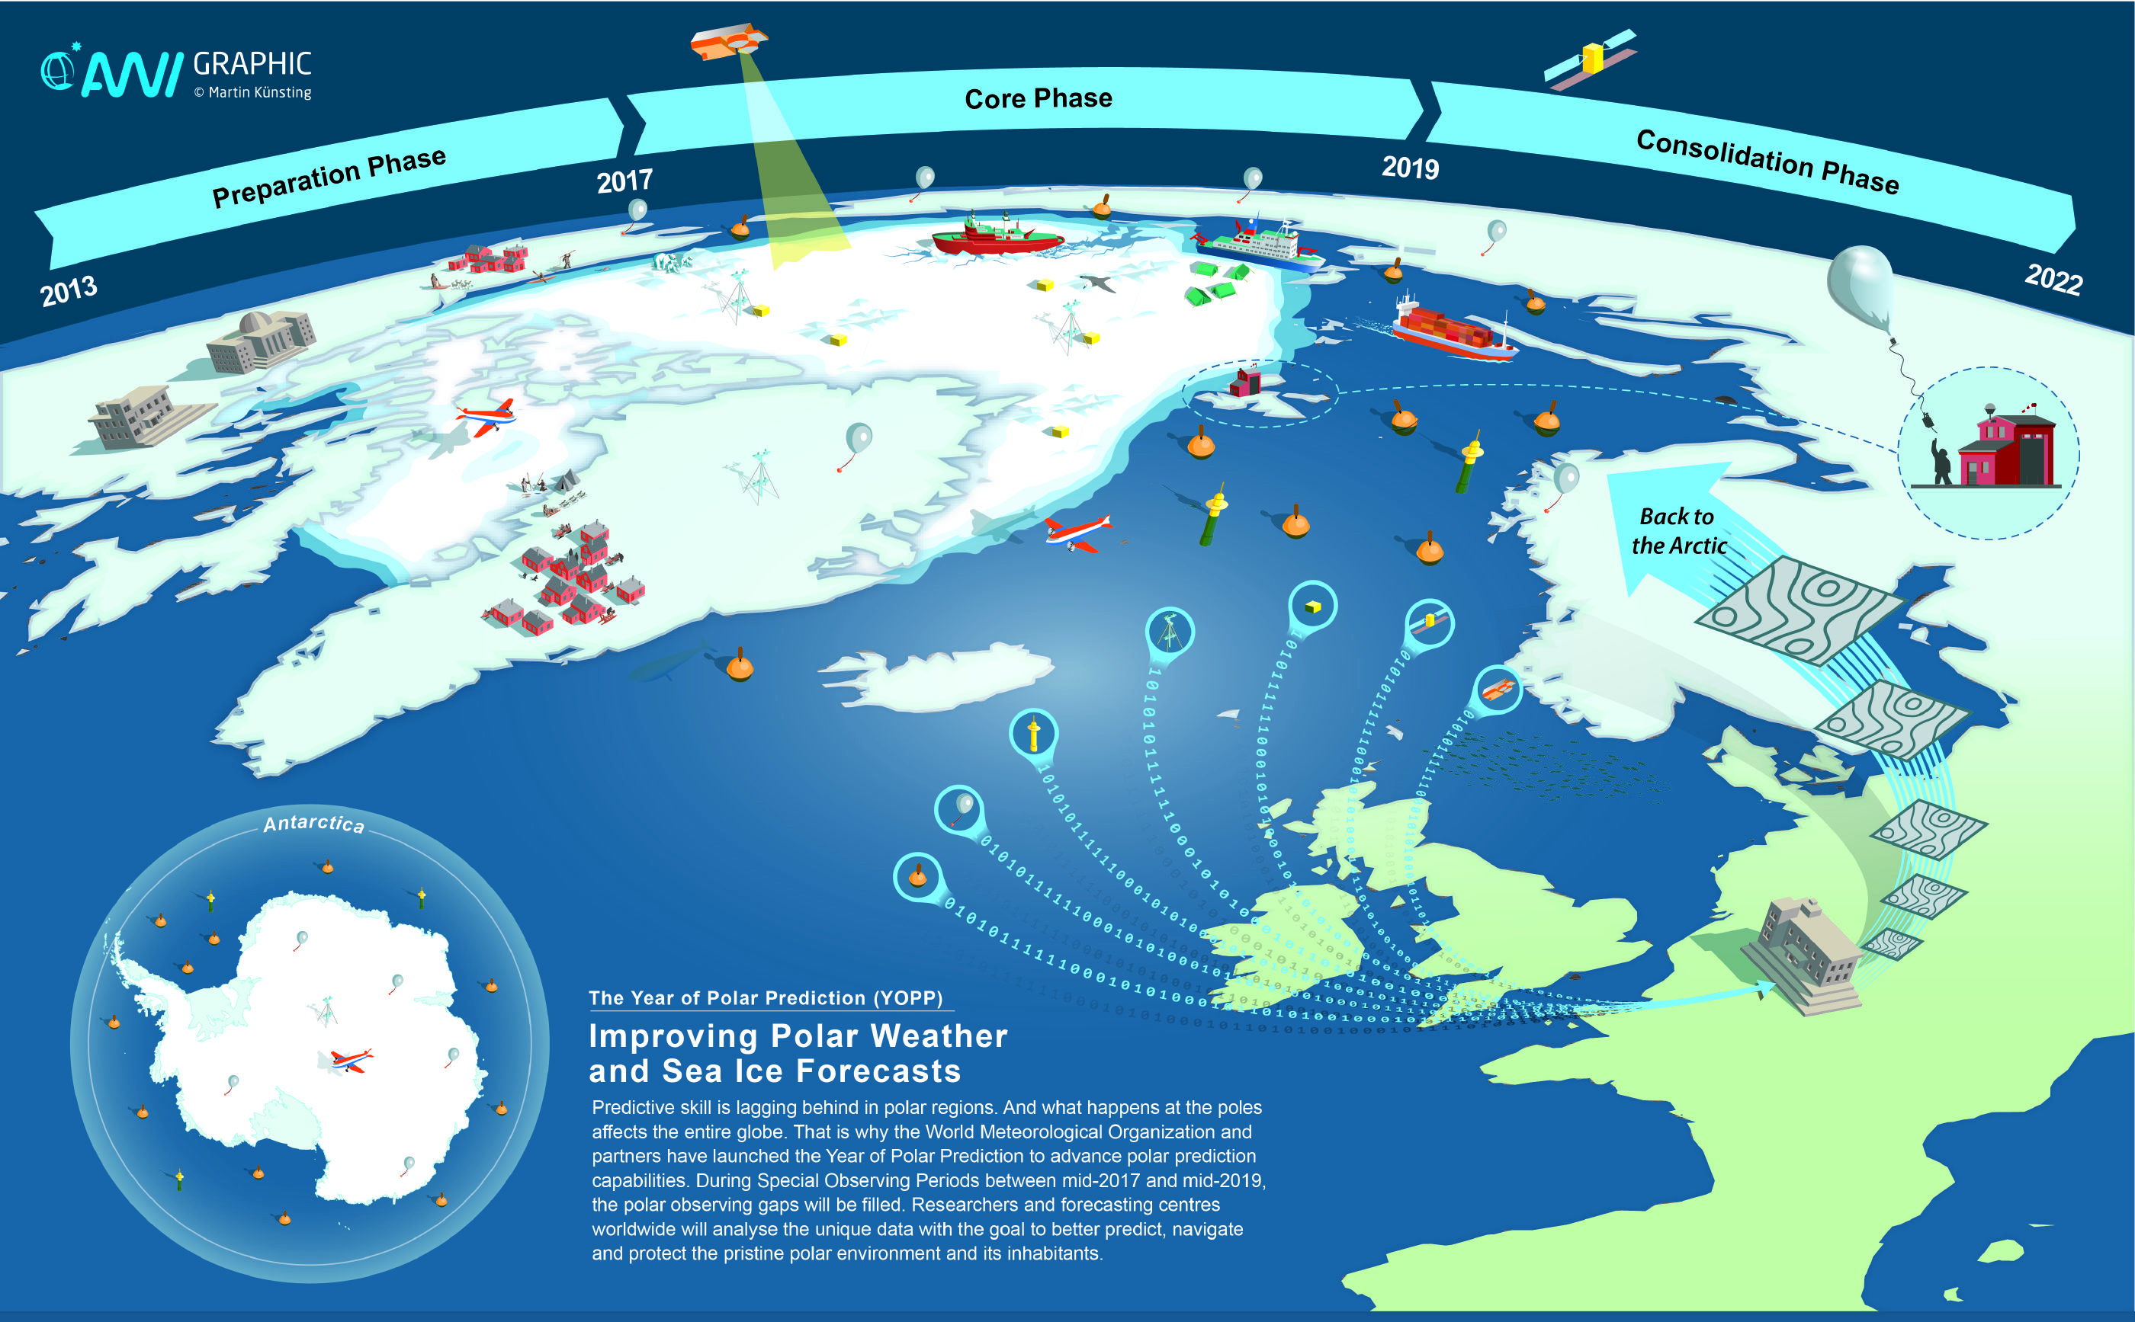
YEAR OF POLAR PREDICTION
Coordinated by the
World Meteorological Organization (WMO)
Period:
mid 2017– mid 2019 (Launch: 15th May 2017)
Goal: Improving predictions of weather and environmental conditions in polar regions and beyond
International collaboration between academia, operational forecasting centres, and stakeholders
Improving the polar observing system, as well as weather and climate prediction models in polar regions
www.polarprediction.net
@polarprediction
Notes:
Graph shows YOPP in a nutshell
Observational component
"routine observing system", in particular radiosondes
Satellite observations (certain products to be made available)
observations from ships and aircrafts
buoys on ice and buoys and floats in open water; GOOD CHANCE TO GET BROAD COVERAGE DURING SOPs, including Russian Arctic!
another aspect: GTS
Bringing together academic research institutions like AWI with forecasting centers (whose strong involvement is rather unique) -> transfer of research into society!
user component: understanding needs of those using forecasts to guide decisions during operations or everyday life in polar regions
Many more aspects hidden here in forecast centres / universities -> transition to endorsement process ->
From CAS Regulations:
The Commission for Atmospheric Sciences shall be responsible for
promoting, coordinating and facilitating research and access to its results,
technology transfer from research to operations, training and capacity-
building activities in atmospheric sciences including weather and its
forecasting, climate, water, atmospheric chemistry, and related environ-
mental sciences.
From the specific objectives:
d) To maintain and develop the World Weather Research Programme,
including the Observing System Research and Predictability Experi-
ment (THORPEX), focusing on knowledge of high-impact weather
and partnerships in multidisciplinary research advancing the broader
science of environmental prediction;

